Slide 1
Assignment 1 Build a performing machine learning algorithm
Course - Big Data Fundamentals - Data Storage Networking
Instructor – Parisa Naraei
Performed by
Harshil Mukesh Bhavsar (C0863170)
Ritu Vinodbhai Kumbhani (C0865677)
Shivam Arvindbhai Machhi (C0871186)

Slide 2
Data Set Information:
Processed Cleveland data contains 14 classes such as age','sex','cp','trestbps', 'chol', 'fbs', 'restecg', 'thalach', 'exang', 'oldpeak', 'slope', 'ca', 'thal', 'num'.
As the num column is the one which defines if the patient has the heart disease or not we have 13 independent variables and 1 dependent variable.
We aim to train the classification model which has the highest accuracy for predicting the value of the num.

Slide 3
Abstract Prediction of heart diseases using Machine Learning Algorithm

Slide 4
MODULES
Upload training data
Data-Preprocessing
Predicting heart Diseases
Graphical representation

Slide 5
Modules Description
Upload Training data:
The rule generating process progresses in two steps. The model is built in the first stage using training data. This model is used to forecast the class labels for each fold. To assess the correctness and precision of the rules, the remaining 20% of test data is used.

Slide 6
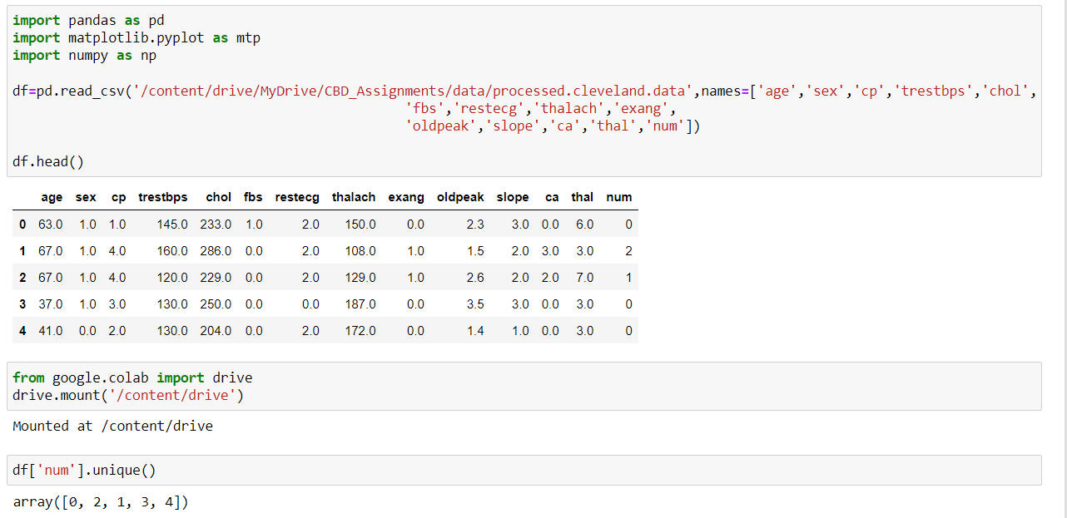

Slide 7
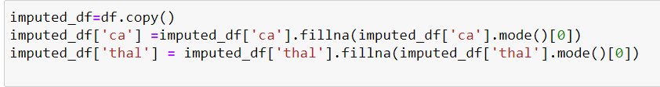
Data Pre- Processing:
After gathering multiple records, preprocessing of heart disease data occurs. There are 302 patient records in the dataset overall, 6 of which have some missing data. The remaining 294 patient records are used in pre-processing once those 6 records have been substituted with mode in the dataset.

Slide 8
Predicting Heart Disease:
The training set is different from test set. In this study, we used 6 various models to predict the accuracy in determining the heart diseases.

Slide 9
Models used to test the heart disease dataset
1. Naïve Bayes (Accuracy of training data – 86%, testing data – 80%)
2. Logistic regression (Accuracy of training data – 86%, testing data – 78%)
3. Decision Tree (Accuracy of training data – 86%, testing data – 78%)
4. SVC (Accuracy of training data – 92%, testing data – 80%)
5. Random forest (Accuracy of training data – 100% , testing data – 75%)
6. Gradient boost (Accuracy of training data – 88%, testing data – 82%)

Slide 10
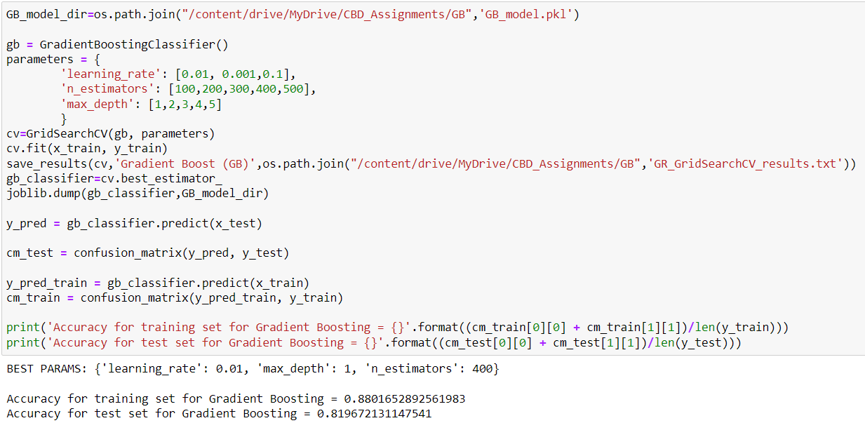
Best model for heart disease prediction
Gradient Boost
We have got the accuracy of 0.82.

Slide 11
Graphical Representations:
On the basis of the approvals and rejections, the analyses of suggested systems are determined. Graphical charts can be used to quantify this. The information may be provided dynamically.

Slide 12
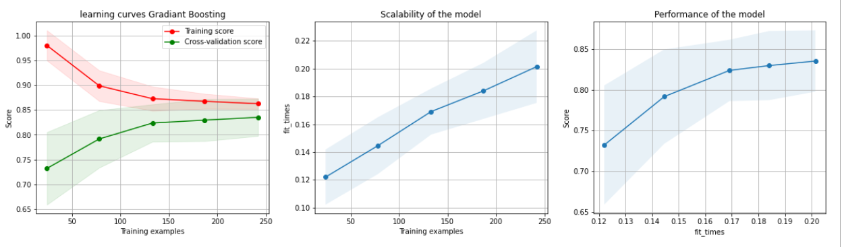
Graph (Gradiant Boost)

Slide 13
Conclusion :-
From the overall training of the 6 classifier models and testing them on the testing set we conclude that we achieved the highest accuracy of 81% with the gradient boosting classifier. The model seems to be performing well and is also not overtrained.

Slide 14
Any questions?

